Slide 1
City Bike Analysis System
An Advanced Python Framework for Urban Bike-Sharing Data Analysis
Presented By: Yasser Nourallah

Slide 2
Project Vision & Deliverables
Core Functionalities: Robust CSV Data Parsing & Cleaning, Efficient Sorting via Merge Sort Algorithm, Statistical Reporting with NumPy, High-Impact Visualizations with Matplotlib.
Goal: Create a modular, maintainable Python system for massive urban data processing.

Slide 3
Software Architecture & OOP
Modular Design: Clear Separation of Concerns (Domain , Logic, Factory, Analytics).
Oriented Programming(OOP): Abstract Base Classes (ABC), Domain Models, Data Encapsulation

Slide 4
Advanced Software Design Patterns
Factory Pattern (Factories): Decouples data creation from file parsing (CSV).
Strategy Pattern (PricingEngine): Dynamically calculates fares based on user types. Easy to extend.

Slide 5
Performance & Algorithmic Efficiency
Custom Merge Sort Implementation: Chosen for its stable and efficient $O(n \log n)$ time complexity on large trip datasets.
NumPy Statistical Logic: Vectorized operations for fast calculation of mean, median, standard deviation, and outlier detection.

Slide 6
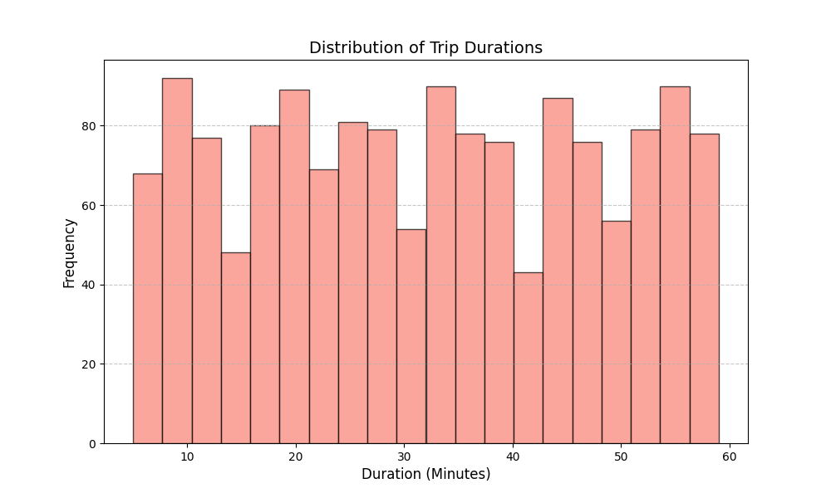
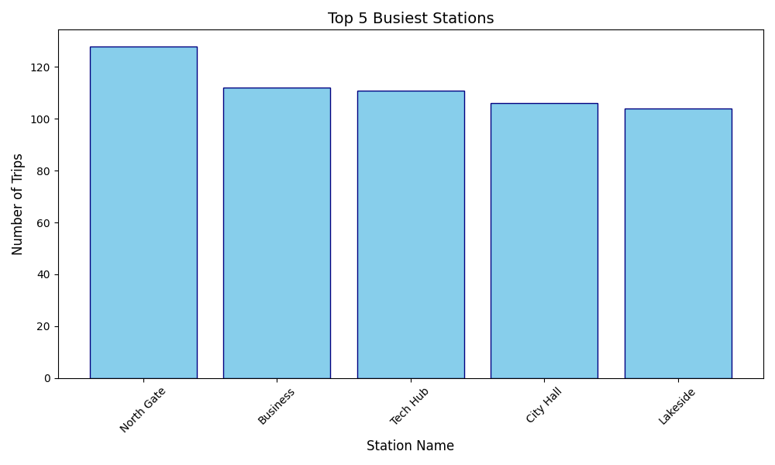
Automated Analytics & Data-Driven

Slide 7
Conclusion & Key Takeaways
Project Status: Complete implementation of all technical Milestones.
Key Achievements: High-performance, robust, and clean Python solution.
Future Work: SQL Database Integration, Live Data Feed, User Interface (GUI/API).

Slide 8
Thank you! Questions?

